Slide 1

Unbound AI and WB Capital
Confidential — July 2025

Slide 2
About Time Someone Built Intelligence into Enterprise AI Security
80% Cost Savings on Coding Agents
55% of Prompts Contain PII
25% of Organizations Ban AI
74-96% LLM Provider Uptime
Over 55% of all prompts contain some form of Personally Identifiable Information, pushing enterprises out of compliance with PCI, SOX and HIPAA regulations
Unbound integrates with Cursor, Cline, and Roo to selectively route requests to models so not every request goes through the most expensive model
Even in 2024, over 1 in 4 organizations have banned all AI apps, keeping them off-limits to employees despite productivity benefits
Top LLM providers have uptimes ranging from 74-96%, requiring automatic error handling and redundancy for enterprise reliability
Unbound's AI Gateway platform provides real-time visibility, control, and protection for organizations deploying generative AI tools, enabling secure AI adoption without compromising productivity.
Sources: MarketsandMarkets, Grand View Research, Lighthouse Global

Slide 3

Unbound's AI-Native Security
Traditional AI Security Approaches
Post-deployment scanning
Post-deployment scanning
Post-deployment scanning
Post-deployment scanning
Post-deployment scanning
Post-deployment scanning

Slide 4
Some Key Observations about Market Structure
Memory Is Still A Huge Bottleneck
Energy Consumption
Over the last few years, compute power has scaled significantly faster than Memory and Bandwidth, leading to latency issues. As parameter size increases in ML models, the delay in data transfer between the GPU memory module to the tensor core which perform the matrix operations become significantly longer.
Megatron-LM language model (smaller than GPT-3) trained by Nvidia over nine days
consumed 2.6x the annual power consumption of avg. U.S. house.
Issues with cooling AI chips are leading to server meltdowns at some CSPs. Cooling
technology now in focus, data centers implementing various liquid cooling technology.
Profitability
Separation of Training and Inference
AI compute demand scales linearly with developer headcount (i.e. when training models).
At scale, GenAI companies could still face meaningful compute costs and fail to reach SaaS
profitability levels. For example, when OpenAI was starting up in 2019-2020, they spent over 120M+ for GCP services.
One way of addressing profitability issues is to separate inference from more intensives training workload and energy-hungry chips, as it requires significantly less compute. Whole slew of startups working to address the issues (ie. Groq, d-Matrix, FuriosaAI, NeuReality, SambaNova, and more)

Slide 5
Competitive Landscape - Enterprise AI Security Market
Vertical | Legacy/Build Your Own | Modern Embedded
AI Gateway Solutions | Manual policy enforcement, VPN-based access | Unbound, Lakera, Robust Intelligence
Data Loss Prevention | Traditional DLP tools, static scanning | Real-time AI prompt redaction, dynamic filtering
Model Management | Single vendor lock-in, manual routing | Multi-model orchestration, intelligent routing
Compliance Monitoring | Periodic audits, manual reporting | Continuous compliance, automated documentation
Cost Optimization | Fixed licensing, over-provisioning | Usage-based routing, cost-aware model selection

Slide 6
WestBridge Partnership

Slide 7
WestBridge Capital At-a-Glance
US-India Fund
~$8b
150+
$1B+
Crossover, Evergreen Fund
Investments
New Tech Investments
60+
40
9
6
Tech Portfolio Companies
Tech Investments
Last 3 Years
Unicorns
IPOs

Slide 8
Best-in-class Cross-Border Team
Patient Capital
10-20 year holding period, leading rounds across multiple stages to save time and bandwidth for founders
Truly Cross-Border
Full-fledged teams in both US and India to support cross-border founders
Operational Expertise
Comprehensive portfolio support teams across talent acquisition, GTM strategy, and customer introductions

Slide 9



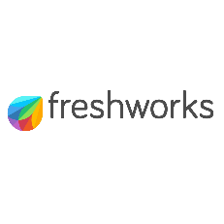




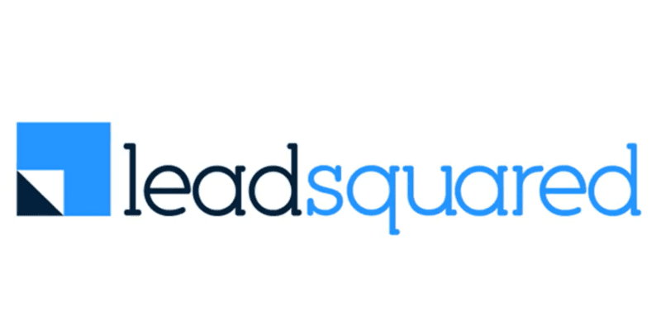





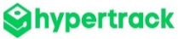



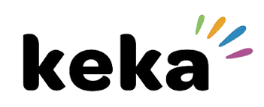



Investments across Sectors and Stages
New
2020 and Prior
2021
2022
2023
2024
2025

Slide 10




Portfolio Acceleration Services
1
2
3
Talent Recruitment
Scaling GTM
Advisory Board
Spearheaded by:
Girish Mirchandani, ex-Pure Storage, HFA
Karan Gurunathan, ex-Google, Flipkart
Initiatives include customer intros to enterprises, channel partners across US/India, competitive research, M&A targets, sales playbook, customer feedback, cost benchmarking
Spearheaded by Peter Kim, ex-LinkedIn, Relativity
Members like:
Patrick Wendell, co-founder Databricks
Manoj Apte, ex-CSO Zscaler
Bill Macaitis, ex-CMO, CRO Slack, Zendesk
Sid Malik, ex-CRO Freshworks
Silicon Valley and Bangalore

Slide 11

Investment Case Study: Turing
AI-enabled Software Services
Our Thesis
Partnership for Growth
Massive Services Market
Best in Class Product
High Customer Traction
Robust Unit Economics
Strong Founding Team
From $10M to $50M ARR
Strategically shifted customer mix from SMB to Enterprises; Built channel partnerships
From $50M to $100M ARR
Restructured GTM to win
$10M+ contracts
IPO ready
Helped turn company profitable and ready for IPO
2020
2021
2022
2023
2024-25
2026
Series B
Invested $28M
Added intelligence across vetting and matching process
Series C
Invested $72M
Lead investor
From $100M to $300M ARR
Expanded focus to LLM data services
We have operationally supported Turing’s growth journey by leveraging our domain expertise
from previous lead investments in Cognizant, GlobalLogic and marketRx

Slide 12
Disclaimer
QUALIFICATIONS:
This presentation contains information about WestBridge Crossover Fund, LLC and its subsidiaries as determined for purposes of US GAAP (the “Fund”) and some of its select portfolio companies and has been prepared solely for your information purposes only. This is not a solicitation or an offer to buy any security or instrument or to participate in any trading strategy of any WestBridge Fund.
The contents of this presentation shall be maintained in strict confidence by all recipients. Any reproduction or distribution of this presentation, in whole or in part, or the disclosure of its contents, without the prior written consent of the Fund is strictly prohibited. Any reproduction or distribution of this presentation, in whole or in part, or the disclosure of its contents, without the prior written consent of WestBridge is strictly prohibited.
The information set forth herein does not purport to be complete and no obligation to update or otherwise revise such information is being assumed. Moreover, certain information contained herein has been obtained from published and non-published sources prepared by other parties and intermediaries, which in certain cases has not been updated through the date hereof. While such sources are believed to be reliable for the purposes used herein, WestBridge does not assume any responsibility for the accuracy or completeness of such information. Further, no third party has assumed responsibility for independently verifying the information contained herein and accordingly, no such persons make any representation with respect to the accuracy, completeness or reasonableness of the information provided herein. Unless otherwise indicated, market analyses and conclusions are based upon opinions or assumptions that WestBridge considers to be reasonable.
Multiple slides show WestBridge’s investment thesis, opinions and beliefs as of the date of this presentation. Any use of adjectives such as “best in class”, “massive”, “robust”, “superior”, “strong”, “dominant” etc. only reflect WestBridge’s belief and view of a particular aspect of the portfolio company as shown in such slides.
There is no guarantee that any investment will perform as projected. Further, the information contained herein does not take into account the particular investment objectives or financial circumstances of any particular investor.
Certain statements, projections or other estimates herein (including estimates of value, returns or performance) are forward looking statements and are based upon certain assumptions. Other events that were not taken into account may occur and may significantly affect the analysis. Any assumptions should not be construed to be indicative of the actual events that will occur. Past performance is not indicative of future performance or results.
No person may treat this presentation as constituting either an offer to sell, or as solicitation of an offer to buy, any interest in the Fund nor does this constitute investment advice or as an offer to participate in the trading strategy of any WestBridge Fund.
Please note that the WestBridge Funds are high-risk investment vehicles and investments therein are available only to qualified individuals or entities that are willing to assume above-average risk and have limited liquidity with a portion of their net-worth. There can be no guarantee that the investment objectives of any WestBridge Fund will be achieved, and an entire loss of principal may occur. Please do refer to the relevant WestBridge Fund’s final confidential offering memorandum, shareholders’ agreement, Form ADV of WestBridge Capital and other related documents for additional information regarding risks and conflicts of interests. No guarantee of investment performance is being provided and no inference to the contrary should be made.

